Slide 1
Automated Classroom Attendance System Using Face Recognition
By Yonathan Cherkos
Advisor: Mr. Nebyu Yonas

Slide 2
Introduction
Problem Statement
Related Works
System Overview
Implementation
Experiment and Result
Conclusion
Contents

Slide 3
Introduction
An automatic classroom attendance system as its name indicated it is a system that is used to automate the manual attendance marking method. Traditionally a teachers take attendance by calling for student name or number and store the result in attendance paper everyday at the beginning of the class. This manual attendance marking method is a repetitive, time-consuming, tedious task. So if we can automating this traditional method, we can save more time for the actual lecture, increase the productivity of teachers, increase students punctuality, and also generate attendance reports and its analysis result easily.
An automated attendance system can be implemented using various techniques of biometrics. Face recognition is one of them which does not involve human intervention. Face recognition is a method of identifying or verifying the identity of an individual using their face.
<number>

Slide 4
Problem Statement
The manual attendance system is a repetitive, time-consuming, and tedious task. An one of the other big problems with manual taking attendance systems especially for high school and lower grades is because of the time limitation a teacher can only take attendance at the beginning of the first class. And many students are not attending the class after break or lunchtime. So one of the main goals of this project is to allow teachers to take attendance at every class(lecture) or at any time they desire and reduce drastically students who are not attending class after break or lunchtime.
<number>

Slide 5
Related Works
There are different biometrics-based attendance marking techniques. An attendance system using fingerprint scanners has been long in the industry. Fingerprint features are considered to be the unique for everyone and fastest method for biometric identification. Despite of fingerprint-based attendance systems being fast and unique for everyone, it required a direct human or students’ interactions with the system to scan their fingers and mark attendance. And also it is hard to take attendance at every session(lecture) of a class or at any time the teachers want using fingerprint scanner.
<number>

Slide 6
System Overview
An webcam will capture a live video stream of the entire classroom and send the capture video stream data to a desktop application for processing. Then the app will detect faces which are present in the video stream. Each of the detected faces will be encoded to 128 dimensional vectors using pre-trained deep learning based face encoder model or to be specific using FaceNet. Then finally each of the encoded faces will pass through the face recognition or face matching subsystem, which will match encoded faces with previously registered student encoded faces. And if a match is found with sufficient similarity and repetition threshold, it will mark the student with the given face as a present. And it will do the same with all the detected faces.
<number>

Slide 7
Implementation
The primary programming language i used to implement the entire application the face recognition modules, user interfaces, and others, has been built with python program. The video pre-processing, face detection, face recognition, and other computer vision tasks have been implemented using OpenCV and dlib library. The app is built and integrated with the face recognition modules using python gui library called PyQt5. I also use different additional python packages like numpy, pandas, imutils, pdfkit, qdarkstyle and others packages. I also use git and GitHub to track my progress.
<number>

Slide 8
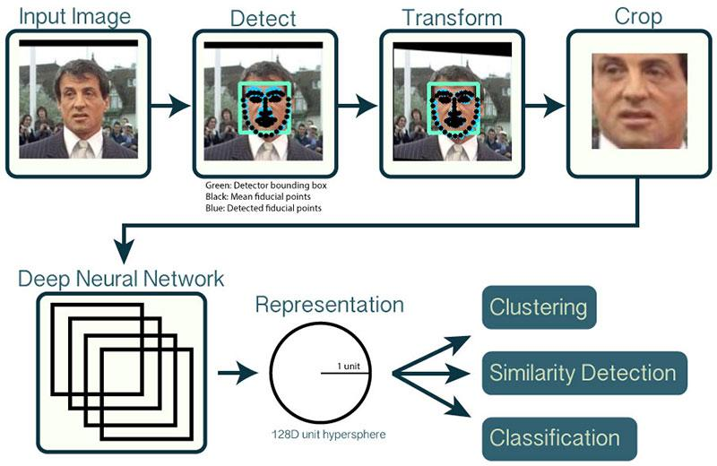
Face recognition pipeline
<number>

Slide 9
Register Students
A authenticated teacher can register students by entering a student’s full name and capture or upload student’s face images. There are two options to insert student face images. The first and recommended approach is capturing student faces using the mounted webcam. This is recommended approach because a face detection model will check for presence of face and draw bounding box on each frame and by doing so it will guide you not to save an frame on which face doesn’t detected. The captured face images should be as different as possible. The face images should capture faces with different emotions, light conditions, orientation, and distance. It is highly recommended to capture or upload 10 to 20 images for each student to generate more diverse face encoding or face representation for each student. The second approach is by uploading already captured student face images.
<number>

Slide 10
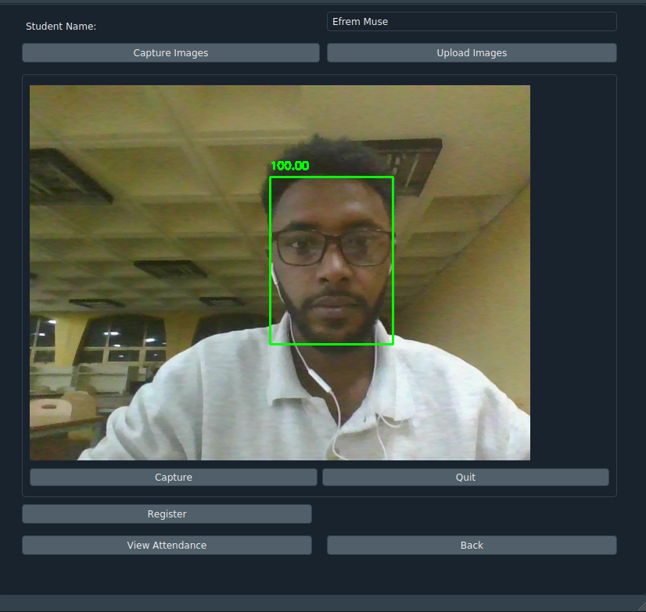
<number>

Slide 11
Take Attendance
After registering some student a teacher can take attendance automatically at the beginning and end of the classes or at any time he/she desires. When a command to start taking attendance is given to the app, it will start recording video and a face recognition system will be applied to each of the frames. To avoid a false negative result the face recognition system will run for about 5 minutes, and after that, it will stop recording and display the student name which is not detected in the video stream for cross-checking purposes. And to avoid false positive result a student will be marked present if he/she is recognized with some repetitions, in my case after 30 repetitions.
<number>

Slide 12
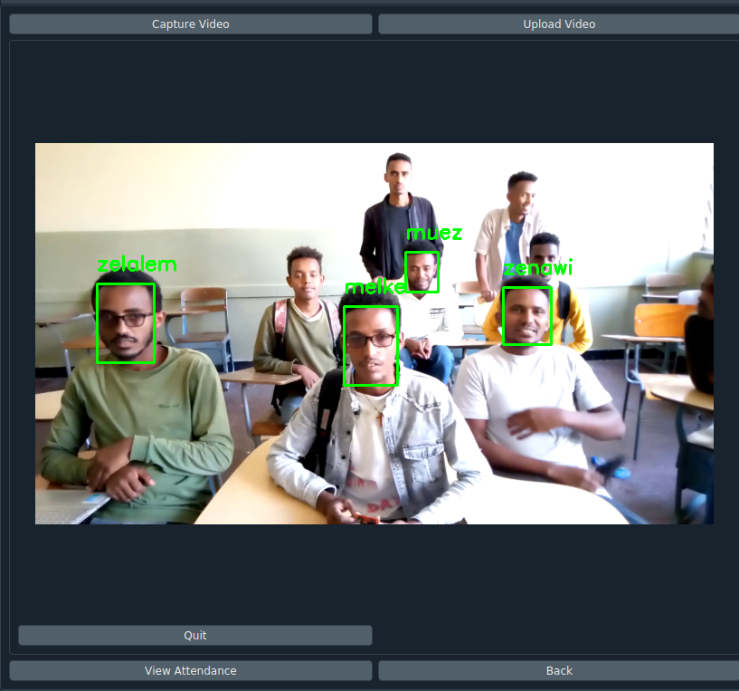
<number>

Slide 13
View Attendance
After taking some attendance a student attendance table will be generated. The table contains lists of the student names and corresponding student attendance percentages. Each of the table rows are colored with different colors based on how much the student attends class. for example, if a student attends class less than 80% the row with the student’s name will be colored red(danger).
The student attendance page has different additional functionality. such as filtering, searching, and saving attendance results to pdf. The filtering option used to display students in different categories separately like good, warning, or danger. There is also a searching option that allows to search for a specific student and display his/her attendance result. The save to pdf options are used to save the table to pdf format.
<number>

Slide 14
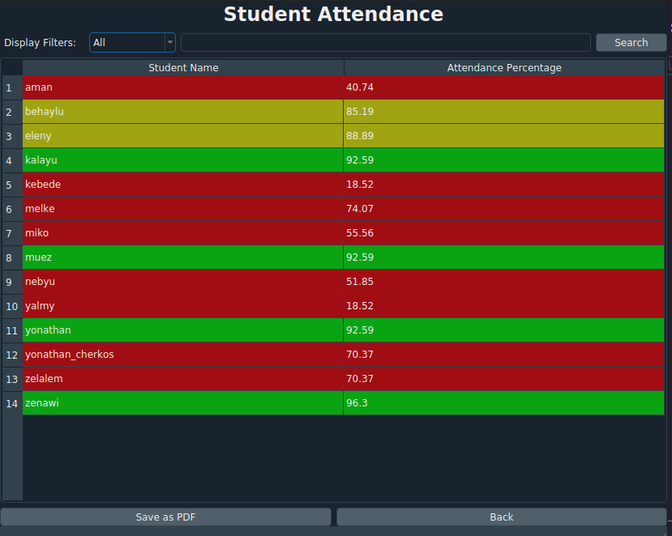
<number>

Slide 15
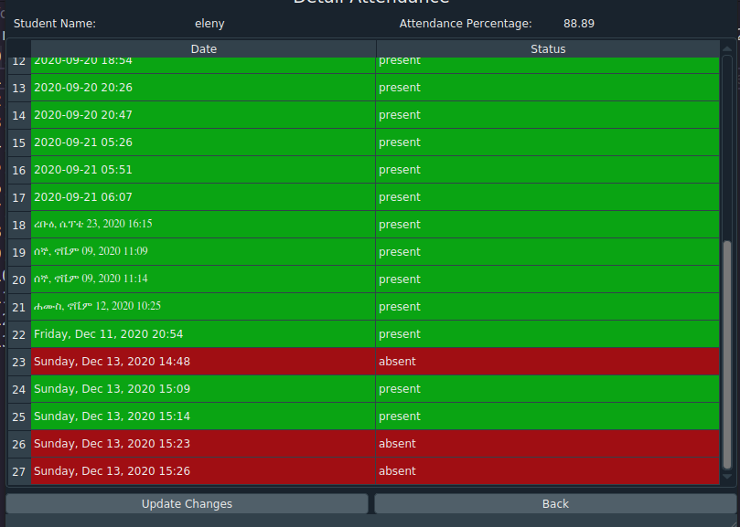
<number>

Slide 16
Experiment and Result
I have experimented with the two most common used face detection algorithms. The first is the most popular viola jones haar cascade face detector. It is very fast but it is less accurate. It fails to recognize faces at a little low lighting condition and different face orientations.
The second face detector algorithm is a deep learning base that has been constructed using ResNet + SSD. Since it uses a large deep learning network architecture, it is computational expansion, it is a relatively slower. But its ability to detect faces at different face orientations and lighting conditions is much better.
Since my requirement for the system is a face detector model with higher accuracy or less false positive face detection result and tolerable speed. After making some comparison experiments, I chose the deep learning-based face detector.
<number>

Slide 17
Experiment and Result
After registering some students I performed a different experiment with the face recognition system. I try to recognize registered students at different face orientations, distances, and lighting conditions. It is able to recognize the face successfully in most of cases. But it sometimes fails to recognize faces in low and a very bright light conditions. But since the app will be used in classrooms which have a sufficient lighting condition, it will work fine for its purpose
<number>

Slide 18
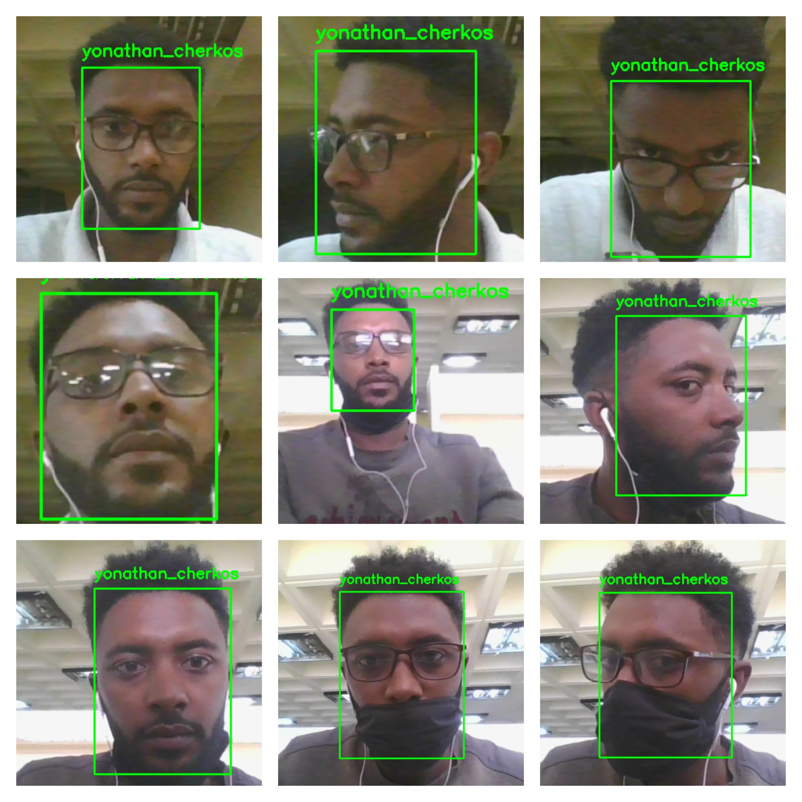
<number>

Slide 19
Conclusion
To conclude, An automated classroom attendance system can save time, increase the productivity of teachers, increase student’s punctuality, and also generate attendance reports and its analysis result easily. And Unlike fingerprinted based attendance system, a face recognition based attendance system doesn’t it required a direct human or students’ interactions with the system to mark attendance
In further work, I intend to improve the system by integrating the entire face recognition modules into a separate hardware modules which will do the whole face recognition pipelines automatically at predefined time. And by adding a cloud database the attendance result will be sent directly from the hardware to the database.
<number>

Slide 20
THANK YOU!!
<number>

